Slide 1
Arizona Rural Transportation Summit
October 19, 2017
Road Funding Campaigns in 2017

Slide 2
Who ATB is…
We are Road builders
Made of contractors, sub contractors, engineers, suppliers, and crafts people
Been in exitance since 1984 and was called the Tucson Utility Contractors Association (TUCA)

Slide 3
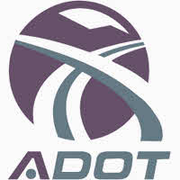
Current Funding

Slide 4
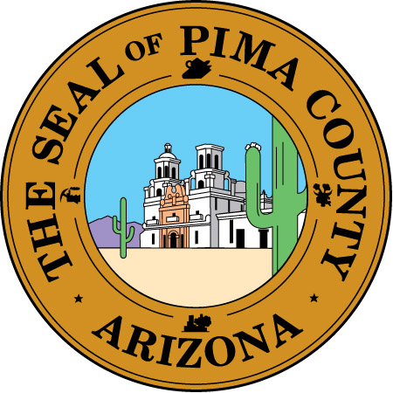
The Last 5-YRS & the Next 5 -YRS

Slide 5
The Last 5-Years
Proposition 409 – Bond Package - 2012
Citywide election
$100 Million total-$20 million annually
Sunset at 5 years
Funding curb to curb – any additional cost occurred paid by the City of Tucson: improve road conditions
Oversite Commission to help oversee funding and planning
Certain roads were pre approved by the City for the voters
**City must pay down its debt service

Slide 6
The Campaign
Small working group
PR Marketing Firm
Mayor’s Friend
ATB/Industry
Raised under $100K
Direct mail, some social media, radio, signs
Met weekly for months

Slide 7
The Results
City voters APPROVED the bond
YES – 72,483 or 50.33%
NO – 71,530 or 49.67%

Slide 8
2017
Proposition 101 – ½ cent Sales Tax for Roads & Public Safety
Citywide election
Roads: $100 million total - $20 million annually
Sunset in 5-years
Funding would include ADA compliance
Oversite Commission to oversee funding and planning
Certain roads were pre approved by the City of Tucson

Slide 9
The Campaign
HUGE working group
PR Marketing Firm out of Phoenix
Police & Fire Foundations
ATB/road industry
Private sector friends close to the Mayor
Raided $700K
Direct mail, large presence on social media, radio & TV ads, signs, weekly walking door-to-door

Slide 10
The Results
City voters APPROVED the bond
YES – 44,192 or 61.48%
NO – 27,694 or 38.52%
** May Special Election

Slide 11
Lesson's Learned/Challenges
HUGE Obstacle – City voters trust
“Go big or go home” attitude
Start early with coalition-find what is important to the public for their support
Deliver the message clearly
Need more stakeholders – more SUPPORT
Find the right marketing firm
Oversite-todays world of sceptics
Layout the plan and stick with it-share reports to the community = TRANSPARENTCY

Slide 12
Pima County
Property Tax Increase for Roads – Residential ONLY
Offset other costs to increase property tax
$19,526,525.00 Million total - ~$20 million annually
Money spent by district & property tax collected
Oversite Commission to oversee funding and planning
Each agency, Marana, Sahuarita, Oro Valley, City of Tucson submit for approval

Slide 13
The Results
County Board of Supervisors APPROVED 3-2

Slide 14
Conclusion
$300 million for roads over 10-years
$200 million in the next 5-years
Proposition 101 finished on time and on budget
saved ~$15 million

